Slide 1



MAJOR PROJECT VIVA VOCE - EXTERNAL
Detection and Prevention of malicious node in WIRELESS SENOR NETWORK
1

Slide 2



Members :
BATCH DETAILS
Vishnu K- RCAS2021MCS202
Supervisor:
Dr.P.Sivaprakash M.Tech.,Ph.D.,

Slide 3
TABLE OF CONTENTS
Introduction
Objective of the project
Base Paper
Challenges in Existing System
Proposed System
Proposed Architecture
Results and Discussion
Conclusion and Future Work
Research Paper Screenshot
GitHub Link
References
09-05-2023

Slide 4
INTRODUCTION
Wireless Sensor Networks (WSN) face significant security threats.
Attackers can intercept or modify information, leading to data tampering or theft.
Malicious nodes can establish better communication channels over long ranges by using superior nodes.
Attackers can forward data through compromised nodes, leading to routing algorithm issues.
malicious node and Blockhole attack is a significant threat that is challenging to detect and stop.
WSN does not have routers, and all nodes use the same routing protocol, which makes the network vulnerable.
The proposed paper suggests a new routing technique to ensure secure data transmission.

Slide 5
OBJECTIVE (S) OF THE PROJECT
To detect the non malicious path with the help of routing protocol AOMDV.
To study the state of art for malicious node prevention and detection in clustered WSN,
To study and evaluate the current work in the field,
To design a hybrid smart technique for the spotting and prevention of wormholes in the WSN
To transmit the data efficiently.
To provide the high security framework
To achieve high QOS such as PDR, Delay, Energy efficiency, Consumption.

Slide 6
BASE PAPER
Work 1:
Title: Detection and Prevention of malicious node in MANETs through reliable multipath routing
Authors: Punith Kumar G.Y, Pushpalatha S
Year: 2022
Key Points:
Technique used for detection and prevention of malicious nodes in MANETs
Reliable multipath routing is used to deliver more packets
Neighboring node's address is used as the bait's target address
Induces RREP to bait the malicious node and respond
Detects the malicious node through the baiting process and prevents the attack
Work 2:
Title: Intelligent Ad-Hoc-On Demand Multipath Distance Vector for Wormhole Attack in Clustered WSN
Authors: Surinder Singh, Hardeep Singh Saini
Year: 2019
Key Points:
Proposed methodology validated based on performance-related parameters
Parameters include energy efficiency, delay from end to end, throughput, and delivery ratio of packets
Various performance-related parameters tested, including energy efficiency, packet loss, and throughput

Slide 7
CHALLENGE(S) IN EXISTING SYSTEM
A malicious node can create holes in a network and receive data packets without informing the source.
The presence of a malicious node can consume the energy of the network's nodes.
A malicious node can disrupt the delivery of data packets.
Processing received packets by a malicious node can affect the overall performance of the WSN.
Malicious node detection and avoidance are crucial in clustered WSNs.
Predicting the presence of a malicious node and finding a hole-free path for data transmission are essential requirements for secure data transmission in WSNs.

Slide 8
PROPOSED SYSTEM
LNCA method: Detects and prevents malicious nodes in WSN clusters using a distributed trust evaluation mechanism.
Detection: Assigns trust values to neighbors based on behavior and communication reliability to identify and isolate malicious nodes.
Prevention: Isolates and replaces malicious nodes with backup nodes, and employs reputation-based mechanisms to discourage malicious behavior.
In-band malicious node attacks: Pretend to be part of a cluster, forward packets to disrupt network operation.
Out-of-band malicious node attacks: Create shortcut paths between clusters to disrupt network performance.
Techniques to address attacks: Use distributed trust management, secure routing protocols, and energy-efficient security mechanisms to detect and mitigate attacks.

Slide 9
PROPOSED SYSTEM
The proposed methods detects malicious node attacks using RTT, PDR, and transmission range features.
The algorithm can detect both out-of-band and in-band malicious node attacks.
The Neighbor ratio threshold (NRT) is used to minimize the number of nodes needed to be detected.
If the neighboring node is outside the transmission range of the source, it is classified as an out-of-band malicious attack.
If the neighboring node is within the transmission range of the source, RTT based on hop count and PDR is used to determine in-band attacks.

Slide 10
PROPOSED SYSTEM
LNCA Technique
There are three sent rounds are made up of the LNCA:
Exchange of findings from reading.
Exchange of nodes for B degree.
Notification from cluster head (CH

Slide 11

MODULE(S)
Sensor node creation
Cluster Head invention
Data transmission
Performance analysis

Slide 12
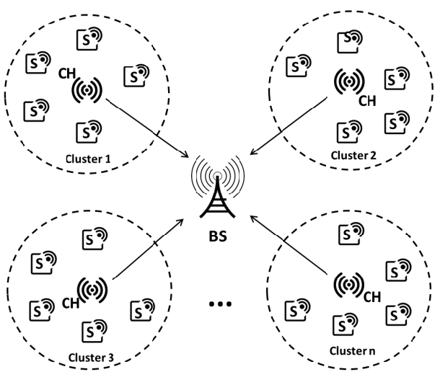
PROPOSED ARCHITECTURE

Slide 13
WORKING ARCHITECTURE
Net deploys sensor nodes
Clustering of nodes using LNCA
The K number of path is created by using AOMDV technique
Source shares DP (Detection Packet) towards destination and receives FP (Feedback packet)
Evaluation of the parameters for every node kept in the routing table like RTT, ETD, Th, P Sent, P Received
On sharing DP, S starts the counter tp1 and stops on receiving FP at tp2
If RTT<ETD
YES
On sharing DP, S starts the counter tp1 and stops on receiving FP at tp2
NO
YES
If P>Th
Inform CH for malicious path
Inform CH for malicious path

Slide 14
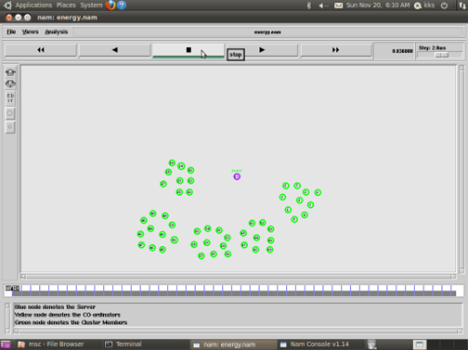
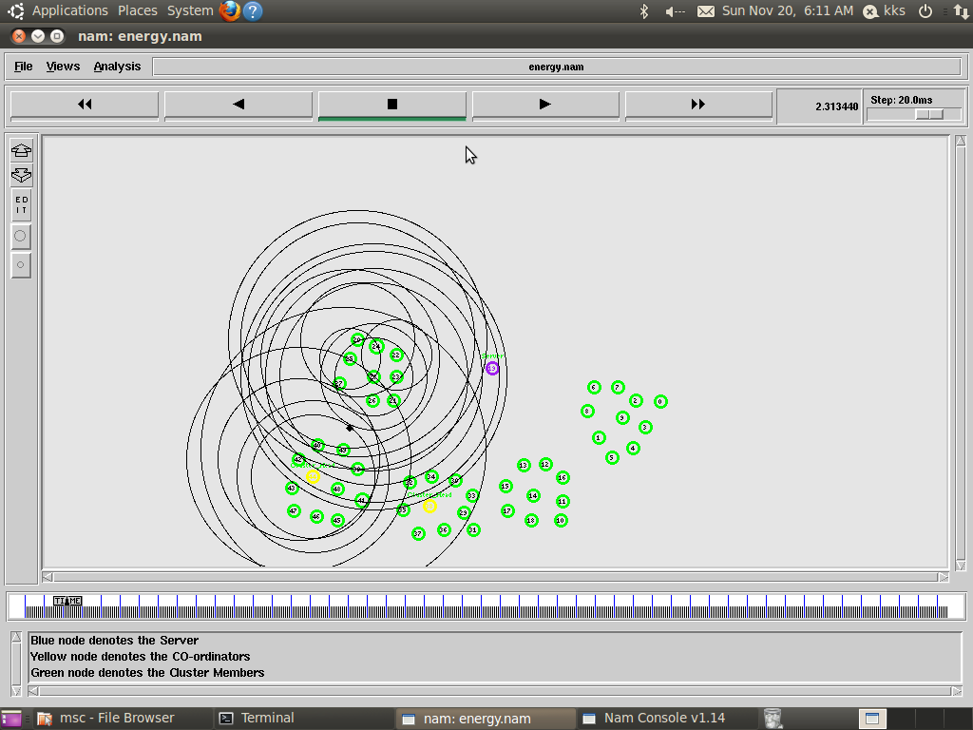
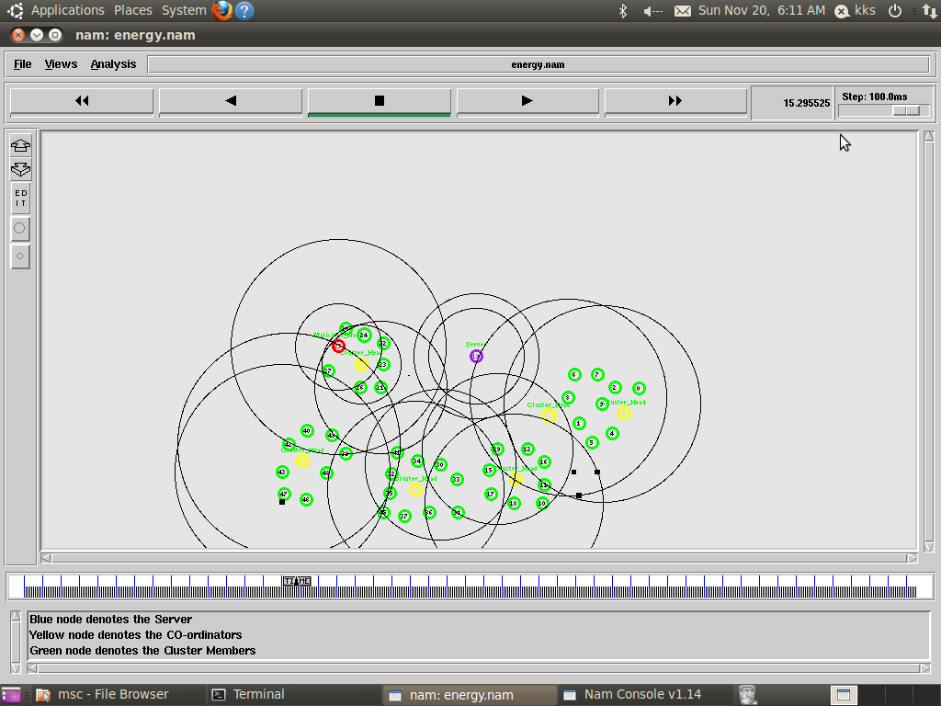
RESULTS AND DISCUSSION
Node distribution over the network
CH Invention
Malicious Node Detection

Slide 15
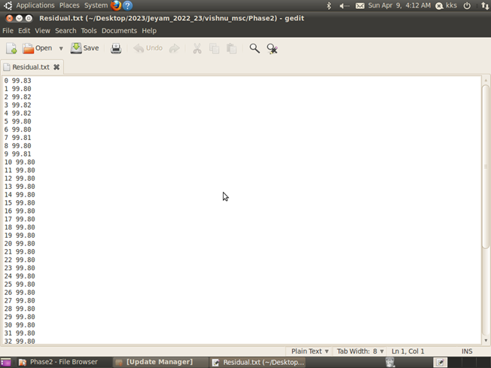
RESULTS AND DISCUSSION
Residual Energy of all nodes
Energy Analysis
PDR And Delay Calculation

Slide 16
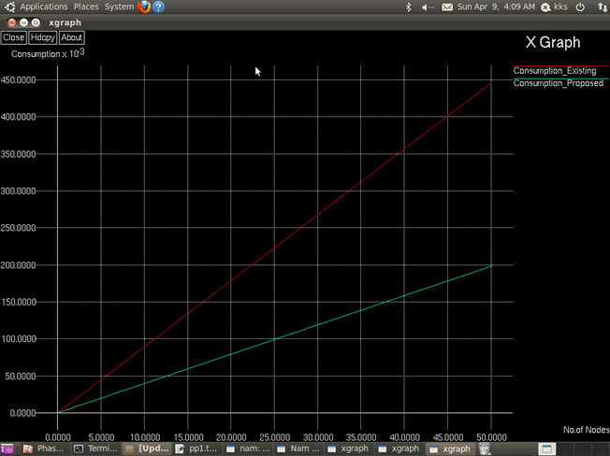
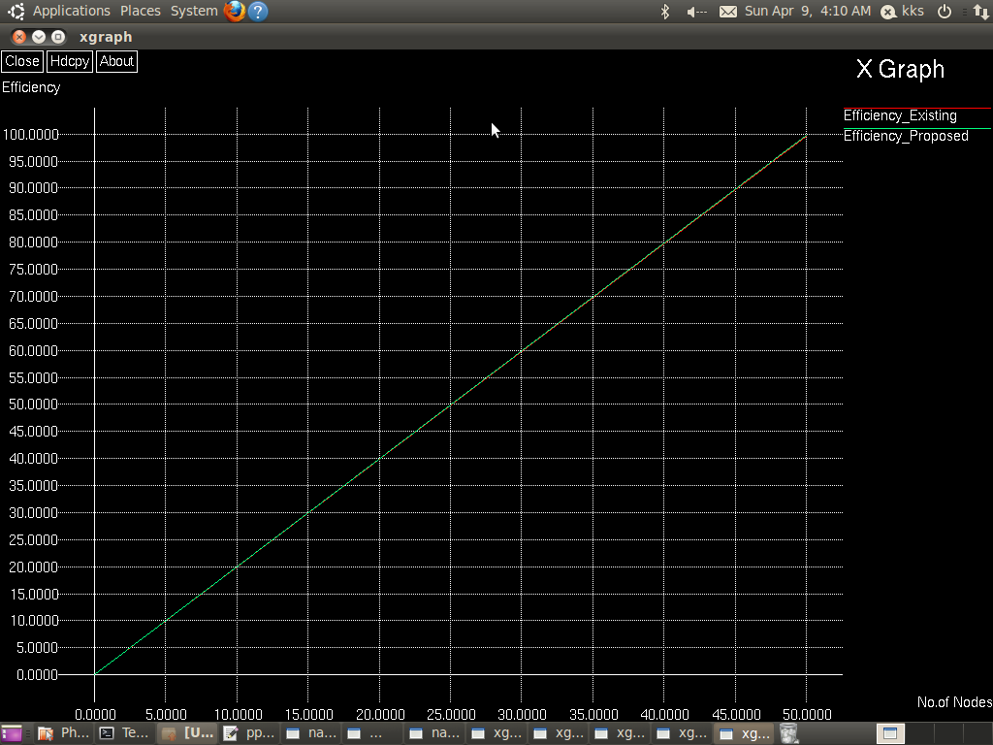
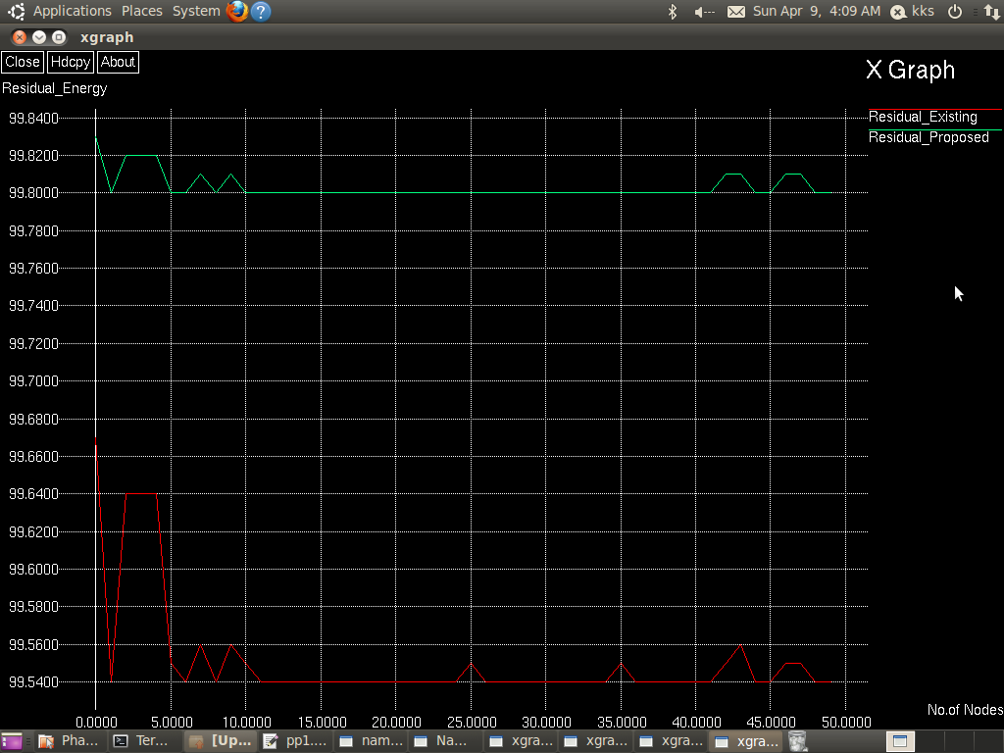
RESULTS AND DISCUSSION
Energy Consumption
Energy Efficiency Comparison
Comparison of Residual Energy

Slide 17
CONCLUSION AND FUTURE WORK
HMND algorithm detects in-band and out-of-band malicious nodes using round trip time and transmission range.
Improved detection leads to more secure wireless sensor networks.
Neighbor ratio threshold reduces energy consumption and enhances algorithm efficiency.
Future focus: Ad-hoc networks in large topological areas for better wireless network detection.
Energy efficiency: Overcoming limited energy supply for mobile nodes.
Prioritizing security: Studying wormhole attack detection to counter complex conditions in HWAD.

Slide 18

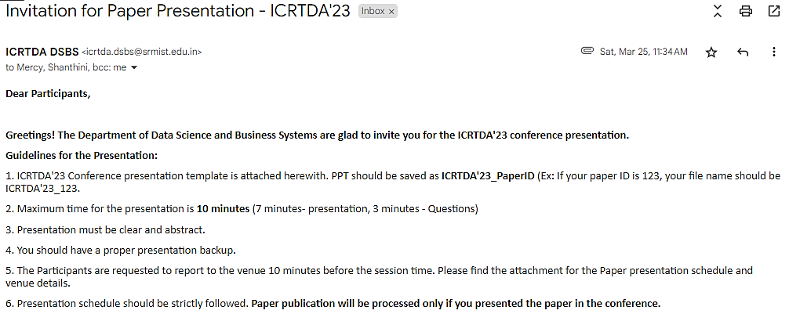
RESEARCH PAPER SCREENSHOT
Attended the ICRTDA'23 international conference at SRM University.
Presented a research paper at the conference.

Slide 19
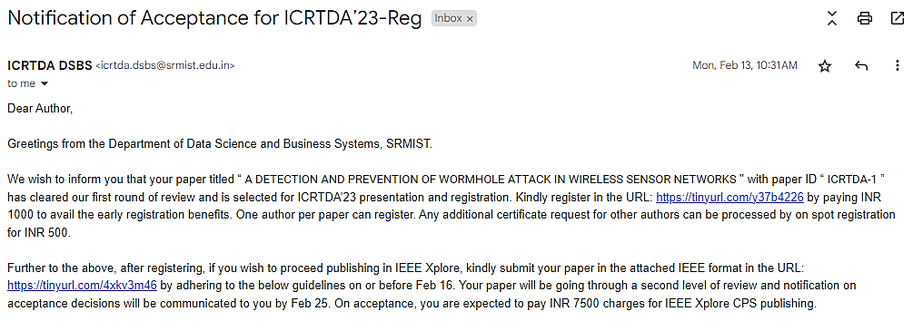
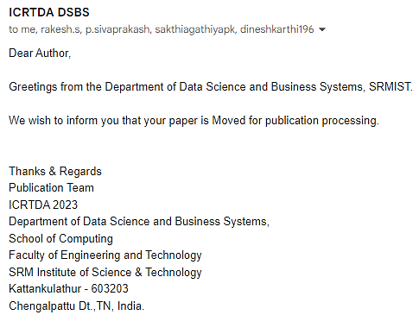
RESEARCH PAPER STATUS
Received notification of paper acceptance for publication in IEEE.

Slide 20
References
GY, P. K., & Pushpalatha, S. Detection And Prevention Of Malicious Node In Manet’s Through Reliable Multipath Routing.Sep 9, 2022.
Singh, S., & Saini, H. S. (2022). Intelligent ad-hoc-on demand multipath distance vector for wormhole attack in clustered WSN. Wireless Personal Communications, 122(2), 1305-1327.
Tahboush, M., & Agoyi, M. (2021). A hybrid wormhole attack detection in mobile ad-hoc network (MANET). IEEE Access, 9, 11872-11883.

